Slide 1
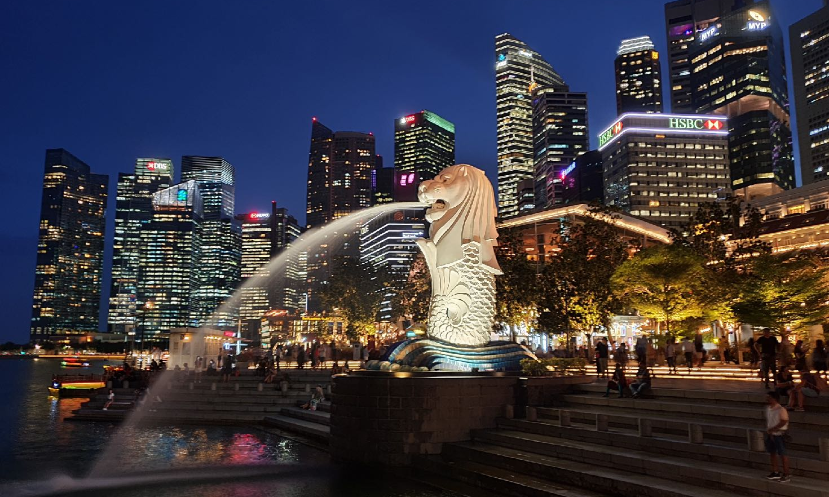
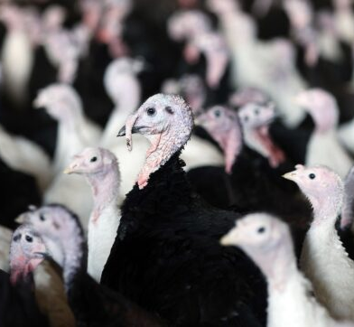
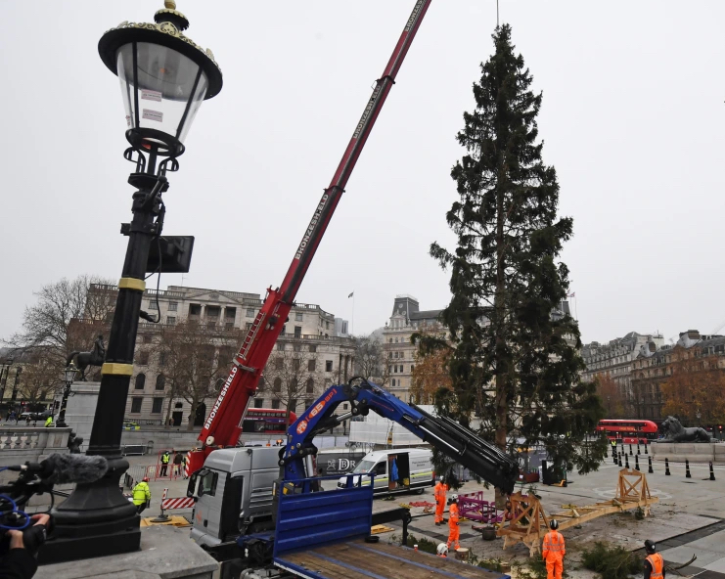
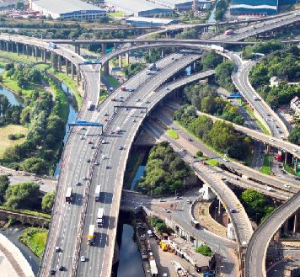
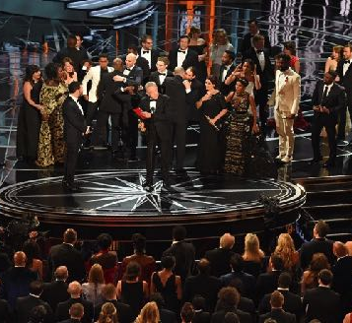
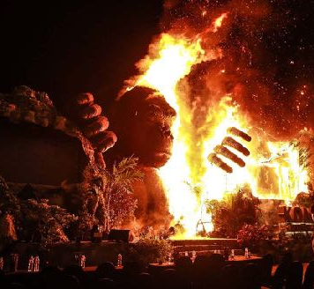
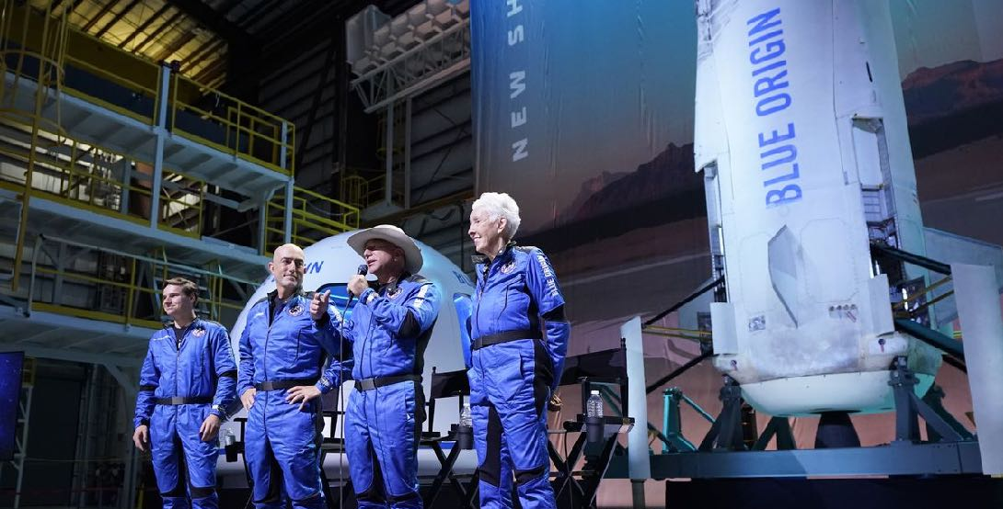
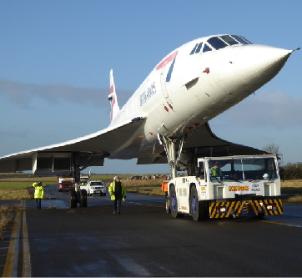
Weekly Quiz Current Events
12 December 2022
06/03/17

Slide 2
Which superhero did Prince Harry recently dress up as for a children's charity Christmas message?
1
a. Superman b. Batman c. Spiderman

Slide 3
Brittney Griner has been returned to America in a prisoner swap deal between the Inter States and Russia. What is Brittany Griner famous as?
2
a. a social media influencer b. a basketball player c. a movie director

Slide 4
Unfortunately, England lost their quarterfinal match against France at the football World Cup. In what year did England manage to claim the trophy?
3
a. 1954 b. 1966 c. 1986

Slide 5
What type of animal has been making headlines and is shown here?
4

Slide 6
An explosion in St Helier destroyed a block of flats and claimed the lives of several people at the weekend. In which UK crown dependency is St Helier the largest town?
5
a. Isle of Man b. Jersey c. Guernsey

Slide 7
Mount Semeru has erupted on the island of Java, throwing a plume of hot volcanic ash 15km into the sky. Which country is Java part of?
6
a. Philippines b. Japan c. Indonesia

Slide 8
What term was named the Oxford Word of the Year for 2022?
7
a. metaverse b. #IStandWith c. goblin mode

Slide 9
At what London location is this tree being installed?
a. Trafalgar Square b. Piccadilly Circus
c. Greenwich Park
8

Slide 10
Which country recently became the first African football team to reach the semifinals of a World Cup?
9
a. Egypt b. Tunisia c. Morocco

Slide 11
Wrexham recently held events to celebrate its new status as a city. In which part of the United Kingdom is Wrexham located?
10
a. Wales b. Scotland c. Northern Ireland

Slide 12
Which famous singer has just been diagnosed with a very rare condition called stiff person syndrome?
11
a. Mariah Carey b. Celine Dion c. Gwen Stefani

Slide 13
What is the name of this city that has just been ranked as the world's first-equal most expensive to live in?
a. Mumbai b. Singapore c. Hong Kong
12

Slide 14
Which of these European cities is closest to London?
13
a. Amsterdam, Netherlands b. Dublin, Ireland c. Edinburgh, United Kingdom

Slide 15
On which streaming platform have Harry and Meghan released their controversial documentary?
14
a. Disney+ b. Netflix c. Amazon Prime Video

Slide 16
Who won an extremely large Euromillions prize of €143 million last week?
15
a. A lighthouse keeper from Norway b. A small village in Belgium c. A group of school teachers from Germany

Slide 17
Which African country has this flag and played in the football World Cup?
a. Senegal b. Ghana c. Cameroon
16

Slide 18
Which part of the United Kingdom has been offered a devolution deal handing it more power to manage local issues?
17
a. Cornwall b. Norfolk c. The Isle of Skye

Slide 19
Which planet is the fifth-closest to the Sun?
18
a. Mars b. Jupiter c. Saturn

Slide 20
True or false, South Korea has a different system for measuring people's age than other countries?
19

Slide 21
For which country does this man serve as Prime Minister?
20

Slide 22
Answers

Slide 23
Which superhero did Prince Harry recently dress up as for a children's charity Christmas message? a. Superman b. Batman c. Spiderman
1
c. Spiderman - Harry donned the superhero’s costume for a clip for the Scotty’s Little Soldiers charity, which supports young people who have lost a parent in the British Armed Forces. The video was shared during the charity’s annual Christmas party, which had the theme Heroes and Villains.

Slide 24
Brittney Griner has been returned to America in a prisoner swap deal between the Inter States and Russia. What is Brittany Griner famous as? a. a social media influencer b. a basketball player c. a movie director
2
b. a basketball player - The US and Russia exchanged US WNBA basketball star Brittney Griner for notorious arms dealer Viktor Bout, held in an American prison for 12 years. Griner was arrested at a Moscow airport in February for possessing cannabis oil and last month sent to a penal colony.

Slide 25
Unfortunately, England lost their quarterfinal match against France at the football World Cup. In what year did England manage to claim the trophy? a. 1954 b. 1966 c. 1986
3
b. 1966 - England won the world cup when it hosted the event in 1966. This is the second world cup in a row where France have beaten England in the knockout stages.

Slide 26
What type of animal has been making headlines and is shown here?
4
Turkey - An outbreak of what disease is badly affecting chicken and turkey farmers in the United Kingdom and United States. Over 50 million birds have died amid a record-breaking outbreak of avian flu in the United States, according to the US Department of Agriculture.

Slide 27
An explosion in St Helier destroyed a block of flats and claimed the lives of several people at the weekend. In which UK crown dependency is St Helier the largest town? a. Isle of Man b. Jersey c. Guernsey
5
b. Jersey - The blast happened at about 4 o'clock in the morning on Saturday. Jersey's gas supplier, Island Energy, said it was working with the fire service to understand what happened. It was earlier confirmed the fire service had attended the scene on Friday night after the smell of gas was reported.

Slide 28
Mount Semeru has erupted on the island of Java, throwing a plume of hot volcanic ash 15km into the sky. Which country is Java part of? a. Philippines b. Japan c. Indonesia
6
c. Indonesia - The eruption prompted evacuations of nearly 2,000 residents. Indonesian officials said no injuries or deaths were reported and evacuees took shelter in public facilities, including village halls and schools.

Slide 29
What term was named the Oxford Word of the Year for 2022? a. metaverse b. #IStandWith c. goblin mode
7
c. goblin mode - It is a term describing "unapologetically self-indulgent, lazy, slovenly, or greedy" behaviour, and seems to have gained popularity since Covid restrictions ended. The runner up was metaverse, with #IStandWith in third. It is the first time the word of the year has been chosen by the public, a decision made in a year organisers described as "more divided than ever".

Slide 30
At what London location is this tree being installed?
a. Trafalgar Square
b. Piccadilly Circus
c. Greenwich Park
8
a. Trafalgar Square - A tree has been gifted to the UK each year since 1947 by the people of Norway as a token of gratitude for Britain's support during World War 2. It is simply adorned with strings of white lights in keeping with Norwegian tradition and stands to represent friendship and hope for future generations.

Slide 31
Which country recently became the first African football team to reach the semifinals of a World Cup? a. Egypt b. Tunisia c. Morocco
9
c. Morocco - The north African nation has beaten some of the heavy weights of world football to reach the semifinal including, Belgium, Spain and Portugal.

Slide 32
Wrexham recently held events to celebrate its new status as a city. In which part of the United Kingdom is Wrexham located? a. Wales b. Scotland c. Northern Ireland
10
a. Wales - It was one of eight places around the UK granted city status this summer as part of the Queen's Platinum Jubilee. The city of around 65,000 residents is now Wales' seventh city, joining Bangor, Cardiff, Newport, St Davids, St Asaph and Swansea.

Slide 33
Which famous singer has just been diagnosed with a very rare condition called stiff person syndrome? a. Mariah Carey b. Celine Dion c. Gwen Stefani
11
b. Celine Dion - The Canadian singer is one of the highest-selling artists of all time. She has had to postpone several European tour dates in light of the diagnosis. The syndrome is incurable and causes sufferers’ muscles to uncontrollably seize up. It affects 1 in a million people.

Slide 34
What is the name of this city that has just been ranked as the world's first-equal most expensive to live in?
a. Mumbai b. Singapore c. Hong Kong
12
b. Singapore - The world's most expensive cities are jointly New York and Singapore, according to the annual Economist Intelligence Unit survey. The Merlion is an icon of the Southeast Asian island nation. It is depicted as a mythical creature with the head of a lion and the body of a fish.

Slide 35
Which of these European cities is closest to London? a. Amsterdam, Netherlands b. Dublin, Ireland c. Edinburgh, United Kingdom
13
a. Amsterdam, Netherlands - At 358km (222 miles), Amsterdam is closest, while Dublin is second-closest (463km), and Scotland is the furtherest of the three (534km).

Slide 36
On which streaming platform have Harry and Meghan released their controversial documentary? a. Disney+ b. Netflix c. Amazon Prime Video
14
b. Netflix - The first three episodes of the six-part bombshell series, titled Harry & Meghan, were released last week. In the documentary, the couple talk about life in the Royal Family, press intrusion and racism.

Slide 37
Who won an extremely large Euromillions prize of €143 million last week? a. A lighthouse keeper from Norway b. A small village in Belgium c. A group of school teachers from Germany
15
b. A small village in Belgium - The winners are a group of 165 people from the village of Olmen in the northern province of Antwerp. Each member of the group will keep about €870,000 each.

Slide 38
Which African country has this flag and played in the football World Cup?
a. Senegal b. Ghana c. Cameroon
16
a. Senegal - England defeated Senegal 3-0 in the Round of 16 at the 2022 Qatar World Cup.

Slide 39
Which part of the United Kingdom has been offered a devolution deal handing it more power to manage local issues? a. Cornwall b. Norfolk c. The Isle of Skye
17
a. Cornwall - The devolution deal includes greater influence to tackle challenges of second homes, control over the adult education budget and support to build affordable homes on brownfield sites. The government has insisted a locally elected mayor, who would lead Cornwall Council, is a necessary requirement for the deal to go ahead. This has prompted protests by some locals.

Slide 40
Which planet is the fifth-closest to the Sun? a. Mars b. Jupiter c. Saturn
18
b. Jupiter - The inner planets (in order) are Mercury, Venus, Earth and Mars. The Outer planets are Jupiter, Saturn, Neptune, Uranus. An asteroid belt lies between the inner and outer planets.

Slide 41
True or false, South Korea has a different system for measuring people's age than other countries?
19
True - However, their parliament has recently passed a law to scrap the two traditional methods of counting age from June 2023. It's an effort to reduce confusion by adopting the same system used in the rest of the world. Currently, the most widely used calculation method in Korea is the so-called "Korean age system", in which a person is one year old at birth and then gains a year on the first day of each new year. In a separate method - the "counting age" - a person's age is calculated from zero at birth and a year is added on 1 January.

Slide 42
For which country does this man serve as Prime Minister?
20
India - Narendra Modi has cemented his popularity in the world's largest democracy, after his BJP party dominated the recent Gujarat state assembly election.

Slide 43
The End

