Slide 2
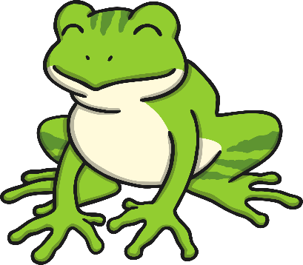
Contents
Cheeky Monkey Hide-and-Seek Addition
Teddy Bears’ Picnic Addition
Pirate Treasure Addition
Jack’s Beanstalk – Counting On Addition
Hibernating Hedgehogs Addition
Picking Apples Addition
Fairy Magic Addition
Dinosaur Addition
Flower Garden Addition
Frog Party Addition

Slide 3
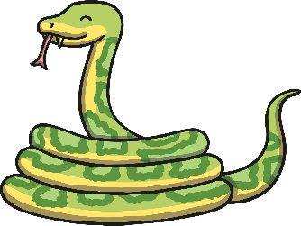
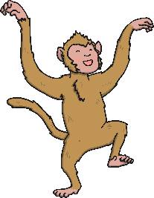
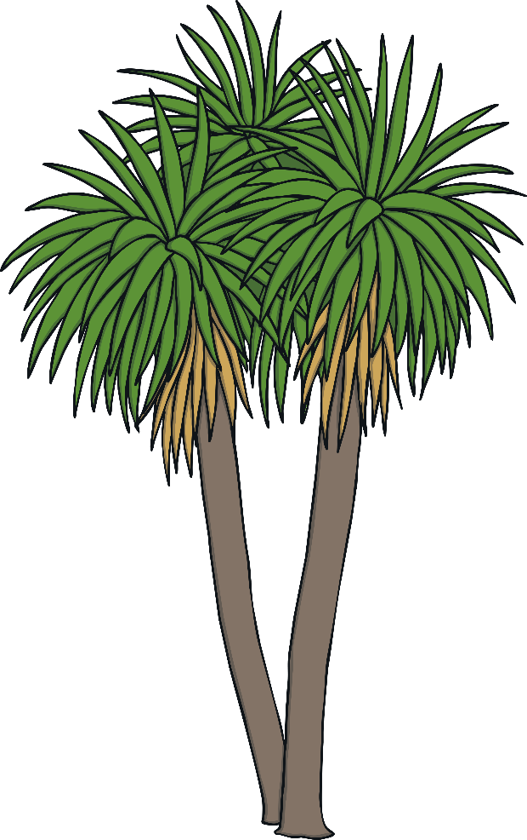
Cheeky Monkey Hide-and-Seek Addition
How many monkeys are hiding altogether?
How many monkeys are in each tree?
Click on the monkeys in the second tree to make them hide in a different place.
When the monkeys move places, how many are there altogether?
click again
reset
Click on the snake to reveal questions that encourage the development of children’s mathematical reasoning skills.

Slide 4
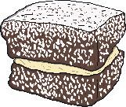
Teddy Bears’ Picnic Addition
How can we work out how many bananas the bears have altogether?
How many apples do the bears have altogether?
The bears are very hungry and are looking forward to their lunch. How many cakes does each bear have? How many cakes do the bears have altogether?
If both bears eat all of the food on their plate, how many pieces of food will have been eaten altogether?
Click on each bear to reveal the food.
click again
reset
Click on the bee to reveal questions that encourage the development of children’s mathematical reasoning skills.

Slide 5
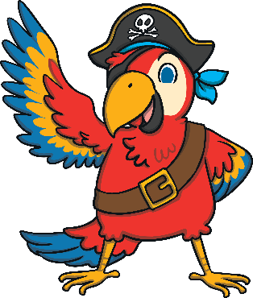
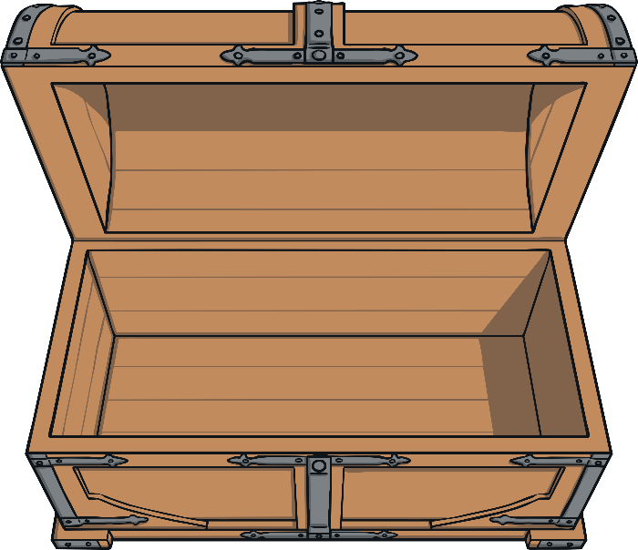
Pirate Treasure Addition
Click on the coins to put them in the treasure chest.
How many silver coins does the other pirate have?
How many coins do the pirates have altogether? How can we check?
How many gold coins does the pirate have?
click again
reset
Click on the parrot to reveal questions that encourage the development of children’s mathematical reasoning skills.

Slide 6
Jack’s Beanstalk – Counting on Addition
On the number line, which number did you start on?
Jack has planted a bean and it is growing. It was 5cm tall and it has grown 3cm more. How tall is it now?
Is the beanstalk getting taller or shorter? How do you know?
10
9
8
7
6
5
4
3
2
1
0
click again
reset
8
Click here for the answer.
Click on Jack to reveal questions that encourage the development of children’s mathematical reasoning skills.

Slide 7
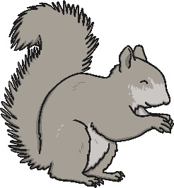
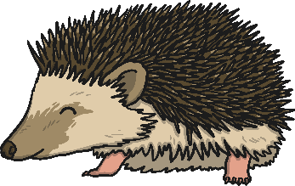
Hibernating Hedgehogs Addition
Are there more or fewer hedgehogs in the nest?
What number did we start with?
What does the ten-frame show you?
Shh! There are 6 hedgehogs hibernating in the nest. Now, 4 more hedgehogs want to sleep in the nest. What is 6 and 4 more? Counting on from 6, click the 4 hedgehogs to add them to the nest.
click again
reset
Click on the squirrel to reveal questions that encourage the development of children’s mathematical reasoning skills.

Slide 8
Picking Apples Addition
How many apples did I pick altogether? How do you know?
What can you tell me about the apples I picked?
Bo has been picking apples. How many red apples does she have?
Which colour apples did I pick more of?
click again
reset
Bo has picked some more apples. How many green apples did she pick?
Click for more apples.
Click on Bo to reveal questions that encourage the development of children’s mathematical reasoning skills.

Slide 9
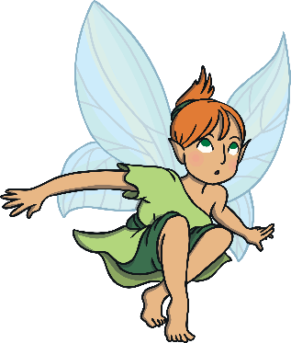
Fairy Magic Addition
Can you explain how you worked out how many fairies there are altogether?
How many fairies are on the first star? How many fairies are on the second star? How many fairies are there altogether?
I think there are 7 fairies altogether. Do you agree or disagree?
click again
reset
Click here to make the fairies appear.
Click on the gnome to reveal questions that encourage the development of children’s mathematical reasoning skills.

Slide 10
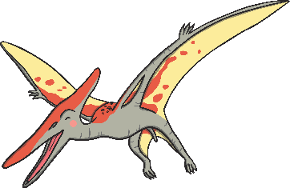
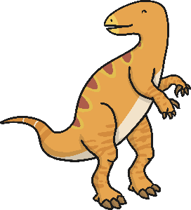
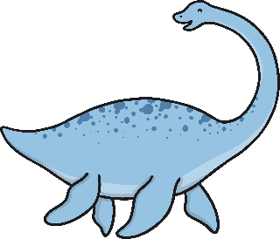
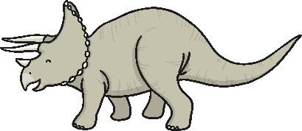
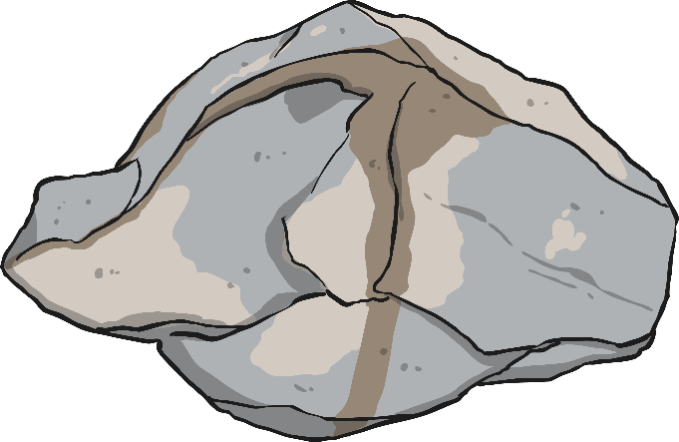
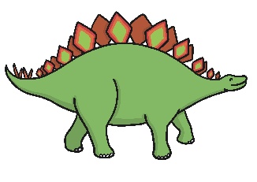
Dinosaur Addition
How many dinosaurs are on each rock?
How many are there altogether?
The dinosaurs are playing on the rocks! Click the first rock to move the dinosaurs.
When the dinosaurs move, does the total number change? How do you know?
click again
reset
Click on the Pterodactyl to reveal questions that encourage the development of children’s mathematical reasoning skills.

Slide 11
Flower Garden Addition
Click the sun to watch the beautiful flowers grow in the garden.
Can you explain what you can see?
What is happening to the flowers?
Can you describe what happened to the flowers using the words more, add and altogether?
click again
reset
Click on Walter Worm to reveal questions that encourage the development of children’s mathematical reasoning skills.

Slide 12
Frog Party Addition
The frogs want to meet up on the big lily pad and have a party! If all of the frogs from both small lily pads go to the party, how many frogs there will be at the party altogether?
There are 8 frogs at the party. If one more frog joined, how many would there be?
When you are adding two groups of objects together, do you always need to start counting from number one?
click again
reset
Click here to reveal the frog party.
Click on Mr Ribbit to reveal questions that encourage the development of children’s mathematical reasoning skills.

